Slide 1

New York Stock Exchange Risk and Return Prediction
Presented by:
Guanzhong (Frank) Chen
Zhe (Peter) Huang
Shiyu Liu
Cangcheng Tang
Jiayuan (Justin) Tian

Slide 2
Data Introduction
Fundamentals:
The quantitative factors extracted from financial statements at the end of each fiscal year
Time range: 2012 to 2016
Prices/Adjusted Prices:
Time series data: Open, close, high, low price and volume for each trade day
Adjusted stock splitting
Dates from 2010 to 2016
Securities
Company information
Will take industry factor from here

Slide 3
Goal & Design
Independent Variables:
Build factors as independent variables
Reflect the company financial condition and the stock risk
Logic
Financial statement is released approximately 3 months after each fiscal year.
Then include three-month return rate as an additional factor when financial statement is released.
Use these factors to predict the stock return rate for the next 3 months and the standard deviation

Slide 4
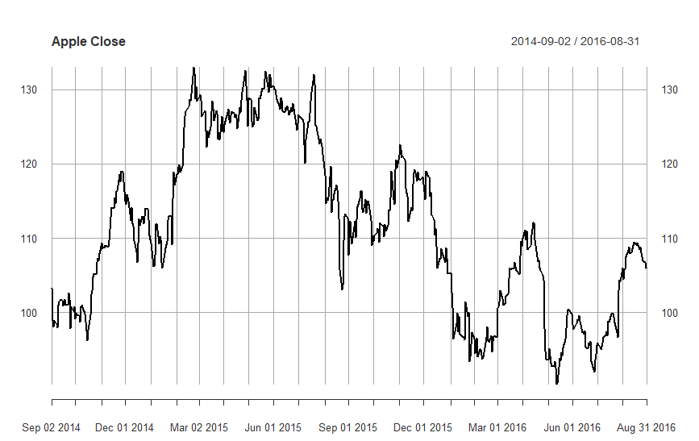
Factors calculated based on financial statements at fiscal year end
Prediction: 4-6 month relative return rate and standard deviation as target variable
-6mo
0mo
3mo
6mo
Factors calculated using time series stock price.
3-month return rate as an additional factor

Slide 5


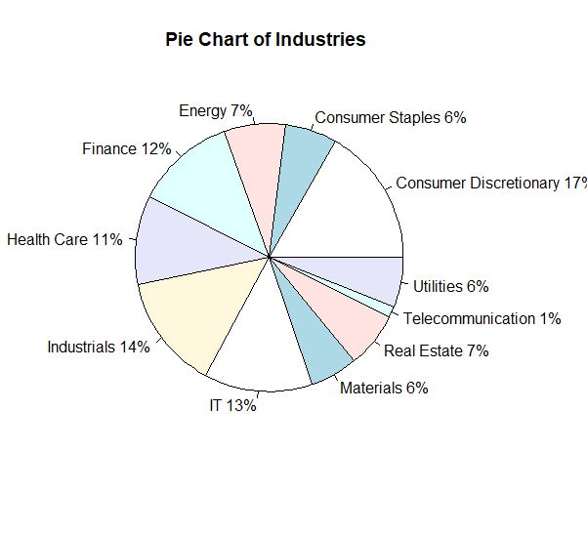
Pie Chart
Show the ratio of companies in different industry

Slide 6
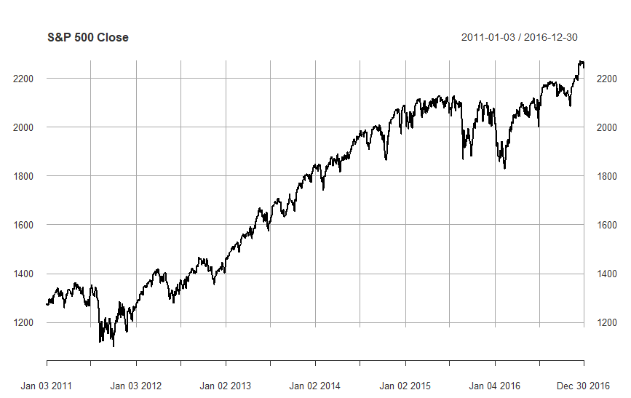
S&P 500 Trend
Show the trend of S&P 500 index from 2011 to 2016

Slide 7
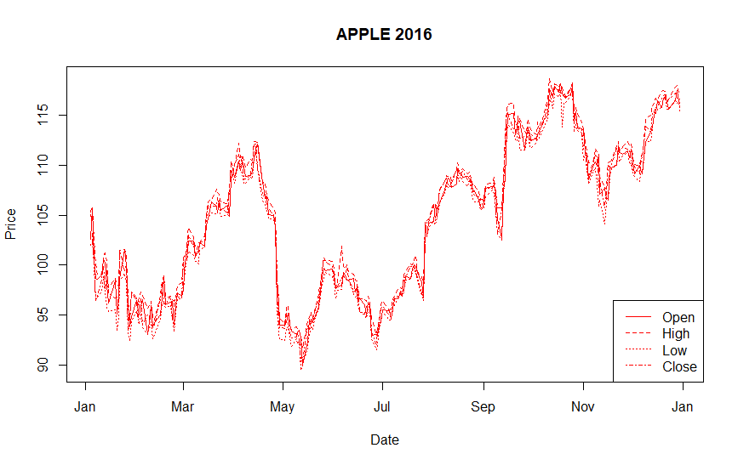
Apple Stock Price
Show the trend of stock price of Apple in 2016
Show four metrics: Lows, Highs, Open, and Close

Slide 8
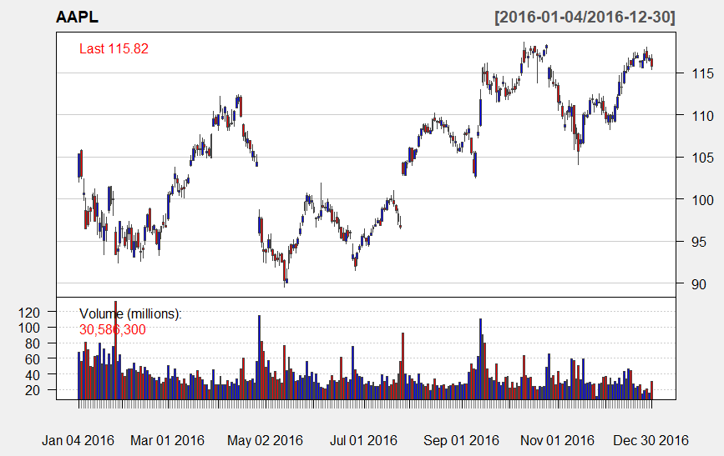
Candle Chart of Apple
Show both the price and volume of Apple in 2016

Slide 9
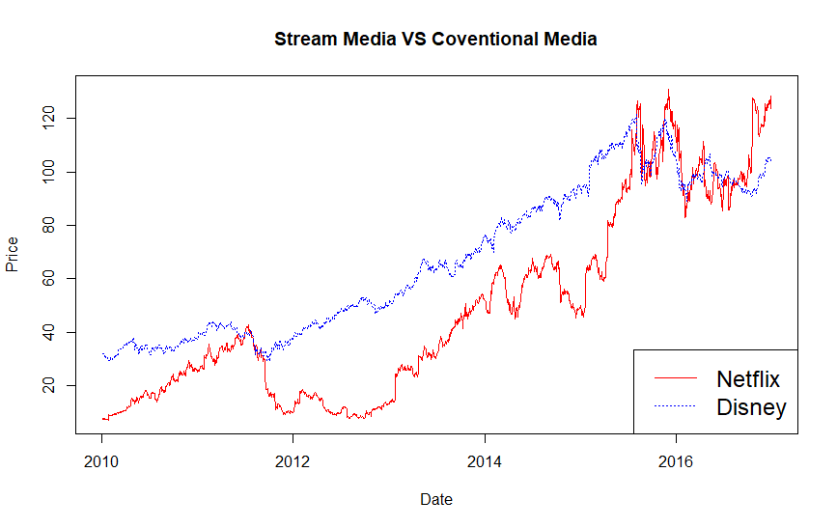
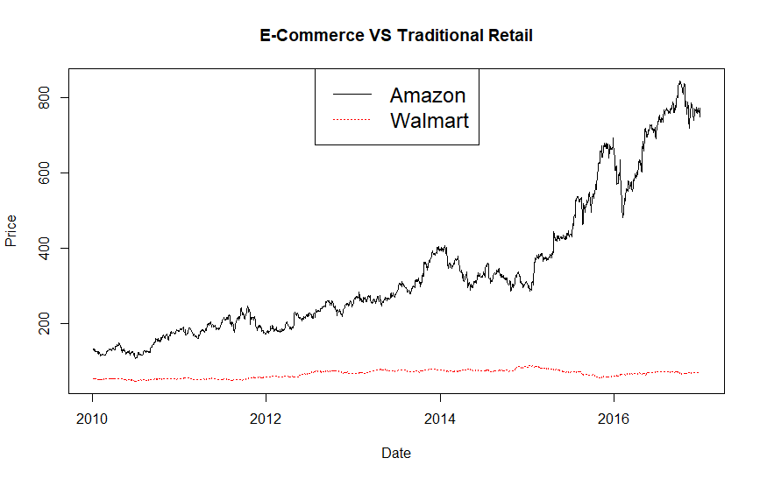
Stock Prices Comparison
Netflix VS Disney
Amazon VS Walmart

Slide 10

Factors----Source: The Barra US Equity Model
The Barra US Equity Model (USE4) is the first in a family of models to include the latest advances in risk methodology, providing institutional investors the ability to align factor structure with their investment processes.
The full version can be found here: http://cslt.riit.tsinghua.edu.cn/mediawiki/images/4/47/MSCI-USE4-201109.pdf
Presented by

Slide 11
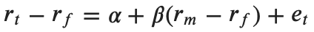
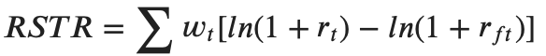
Factors
Current Ratio, Quick Ratio, Profit Margin, After Tax ROE
Directly obtained from Fundamentals
Measures the Company financial health
Size & Nonlinear Size (Cubic)
Log (Shares outstanding * Price)
Capture systematic risk differences between large cap and small cap assets
Beta
(rt--stock return, rf--risk free return, rm--market return)
Describe the components of risk driven by market sensitivity
Momentum
Explains the return of stocks based on their recent relative performance

Slide 12
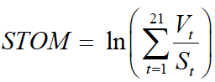
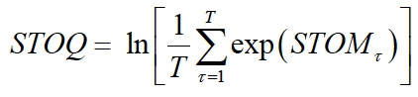
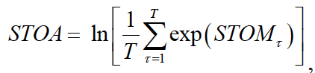
Factors
Residual Volatility
Alpha: Excess Earnings
Residual Std
Explains returns associated with high-volatility stocks that are not captured by the Beta factor
Liquidity: Monthly, Quarterly and Annually Volume
Describes return patterns to stocks based upon their relative trading activity.

Slide 13
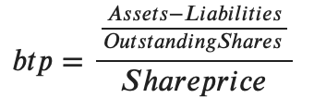
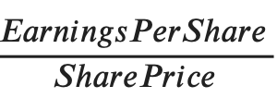
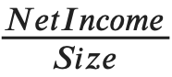
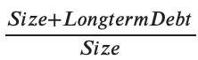
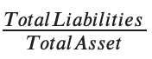
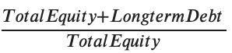
Factors
Book-to-price
Earning Yields
CETOP: Cash earnings-to-price ratio
ETOP: Trailing earnings-to-price ratio
Leverage
Market Leverage
Debt-to-asset Ratio
Book Leverage
The above six factors capture the risk premium associated with the firm’s business model
Notes:
Btp: whether or not a company's stock price is undervalued

Slide 14
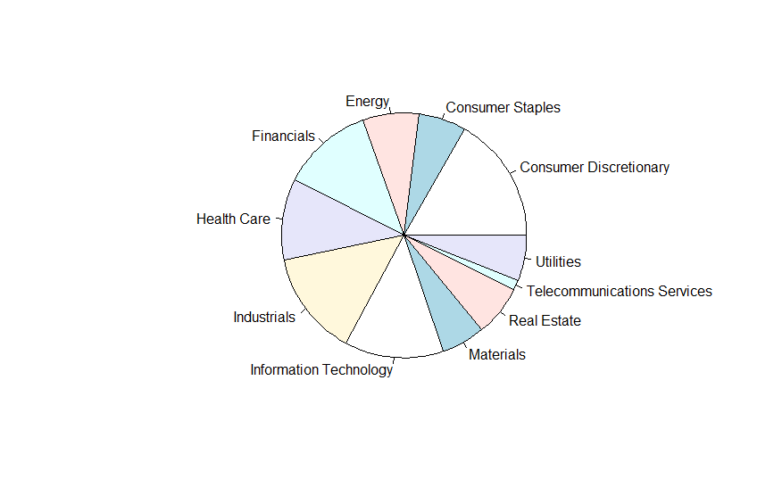
Industry Factors
Industry include 11 categories.

Slide 15
Target Variables
Profitability: Quarterly Return
Total return over the next three month, calculated using adjusted prices
Risk: Quarterly Standard Deviation
Standard deviation of daily return over the next three month

Slide 16
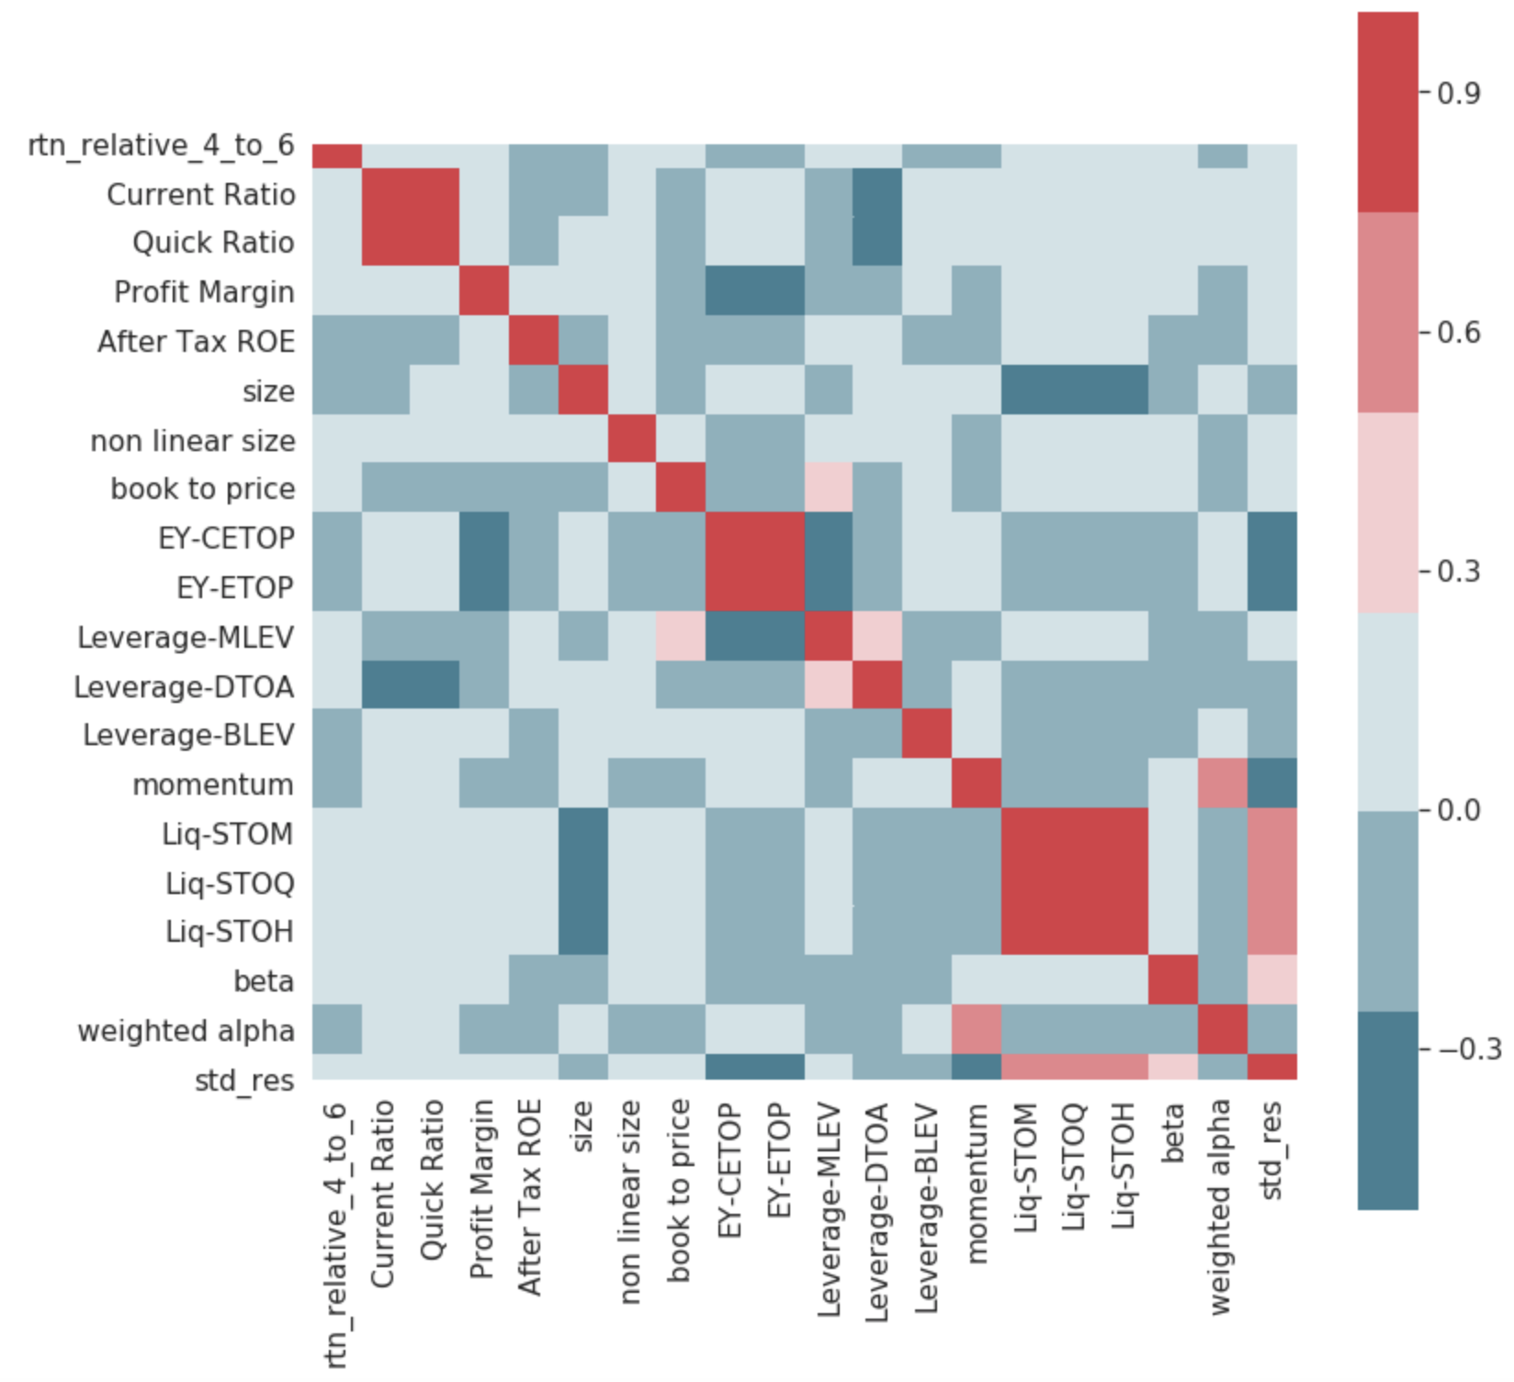
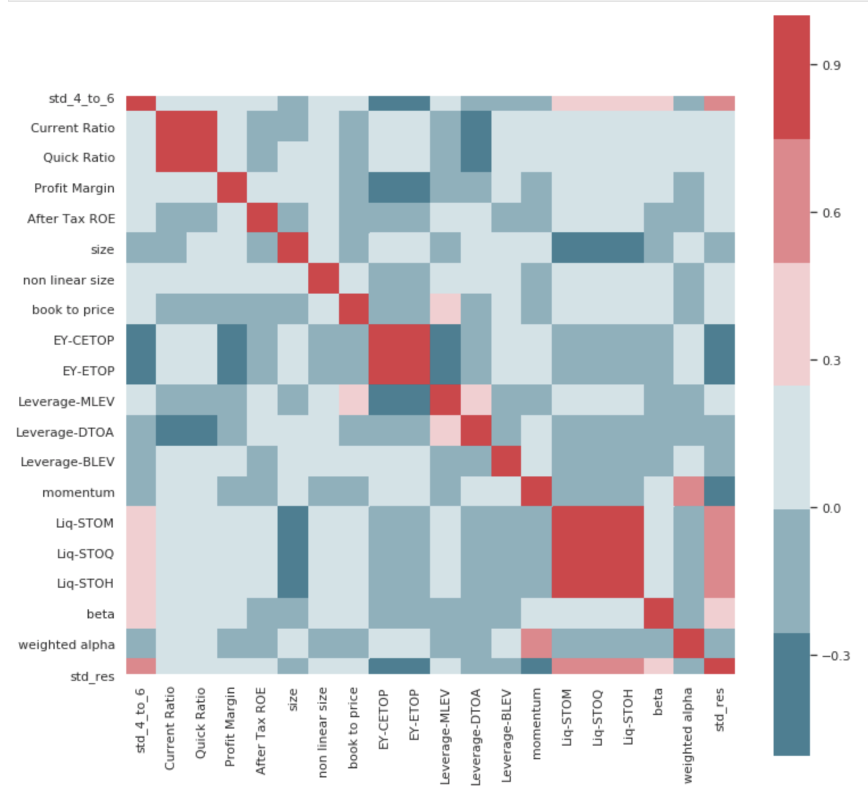
Target & Continuous Variables

Slide 17
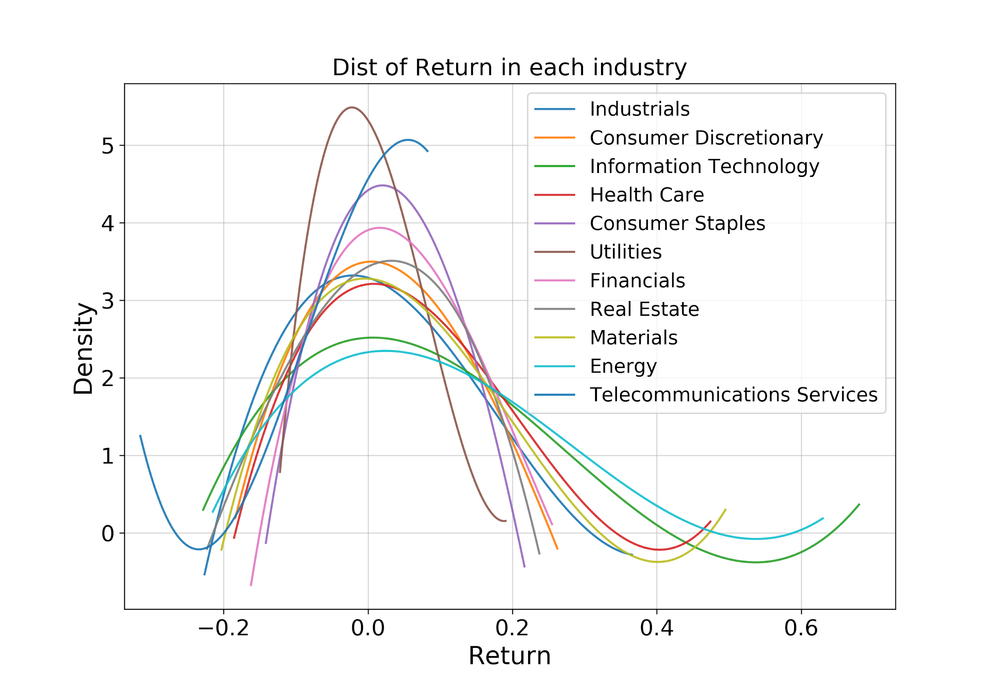
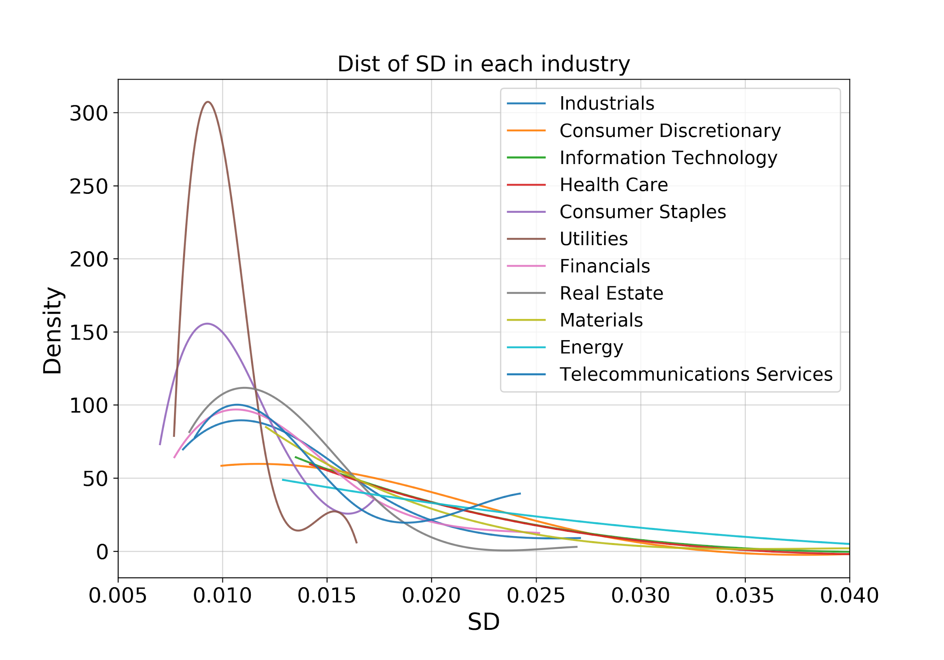
Target & Categorical Variable: Industry

Slide 18
Feature Selection Using stepAIC()
●Strategy:
Train-test Split 0.8~0.2
Forward Stepwise Selection
●Algorithm:
○Start with Null Model M_0
■model_init = lm(half_year_return ~ 1, data = data_trn)
■model = lm(half_year_return ~ ., data = data_trn)
Notes:
After understanding the target variable, we want to perform the feature selection. First we perform train test split with portion of 0.8 and 0.2 using createDataPartition method in R. Next, the stepAIC() function performs forward model selection for the training dataset. While the best subset selection procedure considers all 2^p possible models containing subsets of the p predictors, forward stepwise considers a much smaller set of models. Forward stepwise selection begins with a model containing no predictors, that is the null model, and then adds predictors to the model, one-at-a-time, until all of the predictors are in the model.

Slide 19
Feature Selection Using stepAIC()
●Algorithm:
○For k = 0,1,…,p-1
■Consider all p-k models that augment the predictors in M_k with one additional predictor
●At first k = 0, we have a total of p models to choose from. Each contains only one covariate. Repeat the process so on and so forth.
■Choose the best among these p-k models, and call it M_(k+1)
●Best: smallest RSS
Notes:
Unlike best subset selection, which involved fitting 2^p models, forward stepwise selection involves fitting one null model, along with p - k models in the kth iteration, for k = 0, . . . , p - 1. In Algorithm, we must identify the best model from among those p-k that augment Mk with one additional predictor. We can do this by simply choosing the model with the lowest RSS.

Slide 20
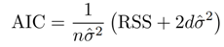
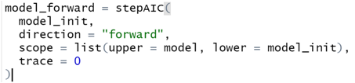
Feature Selection Using stepAIC()
●Algorithm:
○Select the best model from M_0 ,…, M_p using AIC
Notes:
However, to identify the best model among a set of models with different numbers of variables. We need to use a metric called AIC. The AIC criterion is defined for a large class of models fit by maximum likelihood. Where d is the number of predictors, and σˆ2 is an estimate of the variance of the error associated with each response measurement. Essentially, the AIC statistic adds a penalty of 2dσˆ2 to the training RSS in order to adjust for the fact that the training error tends to underestimate the test error. Clearly, the penalty increases, as the number of predictors in the model increases; this is intended to adjust for the corresponding decrease in training RSS. As a consequence, the AIC statistic tends to take on a small value for models with a low test error, so when determining which of a set of models is best, we choose the model with the lowest AIC value.

Slide 21
AIC Feature Selection
Quarterly Return
Earning yields: cash earnings-to-price ratio,
Industry factor,
Non linear size,
Size,
Return of the first 3 month,
After tax ROE,
Leverage: debt-to-asset ratio,
Beta,
Current ratio,
Profit margin,
Book to price
Quarterly SD
Residual standard deviation,
Standard deviation over the past 3 month,
Half-year liquidity,
Quarterly-year liquidity,
Beta,
Return of the first 3 month,
Trailing earnings-to-price ratio,
Quick.Ratio,
Profit.Margin,
Momentum,
Weighted alpha over the past 3 month
Notes:
After all, 11 variables were selected for both quarterly return and standard deviation. More will be elaborated later. And now Peter will talk about cross validation.

Slide 22
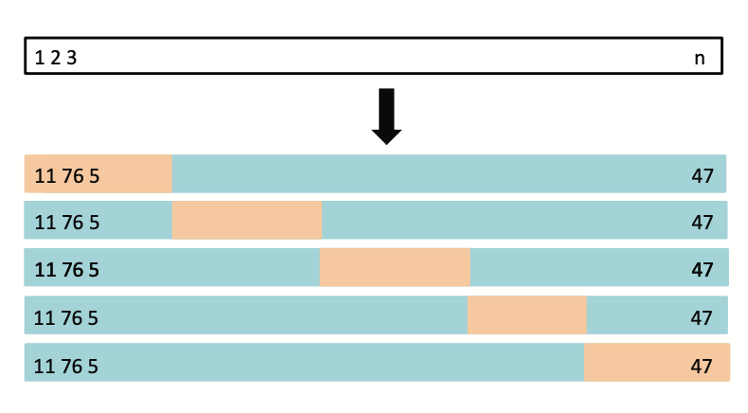
Cross Validation
Notes:
So we also try to get better prediction results by using cross validation to tune different model parameters. So just a quick recap of cross validation. We divide the training set into several folds (in our case, 5 folds), and each fold will be used as test set in turn to measure the performance of the model trained by the training set, and thanks Roberta for the image.

Slide 23
Cross Validation
R Packages: caret, elasticnet
5 folds
Metric: root mean square error (RMSE)
Methods
K-nearest neighbors (KNN)
Ridge
Elastic net (including Lasso)
Notes:
We used two R packages in the training process. The first one is caret, it is a great package for cross validation, and the elastic net package is for the training of ridge regression and elastic net. We used 5-fold cross validation in all models. The metric we use is RMSE, because it directly shows the average error of the prediction. We used three different methods: k nearest neighbors, ridge regression, and elastic net, and here the elastic net includes the case of Lasso.

Slide 24
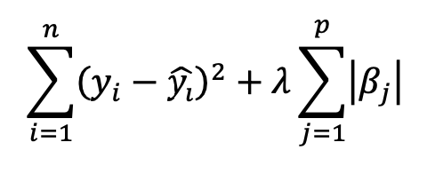
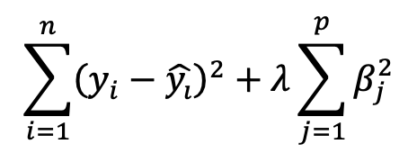
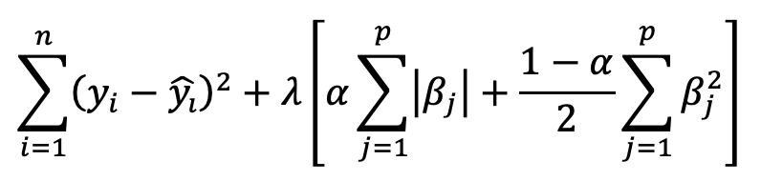
Elastic Net Regularization
Lasso: minimizes
Elastic net: minimizes
Ridge: minimizes
Notes:
And here I want to talk more about elastic net regularization. So we are familiar with Lasso, or L1 regularization, and Ridge, which is L2 regularization. So in simple terms, elastic net is the combination of Lasso and Ridge. Its loss function adds up both L1 and L2 error with a mixing percentage alpha. So for elastic net, the tuning parameters are alpha and lambda. And you may have noticed that there is an one half before the L2 error, this is just for the mathematical convenience for optimization.

Slide 25
Results - Quarterly Return
Model | Cross-validated RMSE | Test RMSE
Linear regression | 0.1109 | 0.1001
K-nearest neighbors | 0.1094 | 0.0995
Ridge | 0.1127 | 0.0996
Elastic net | 0.1106 | 0.0993
Notes:
And here’s the results for predicting quarterly return. I also put linear regression here for comparison. As you can see here, these three models perform slightly better than linear regression as they have smaller test RMSEs. All models have test RMSEs around 10%, and elastic net has a small advantage over KNN and ridge regression with an RMSE of 9.93%.

Slide 26
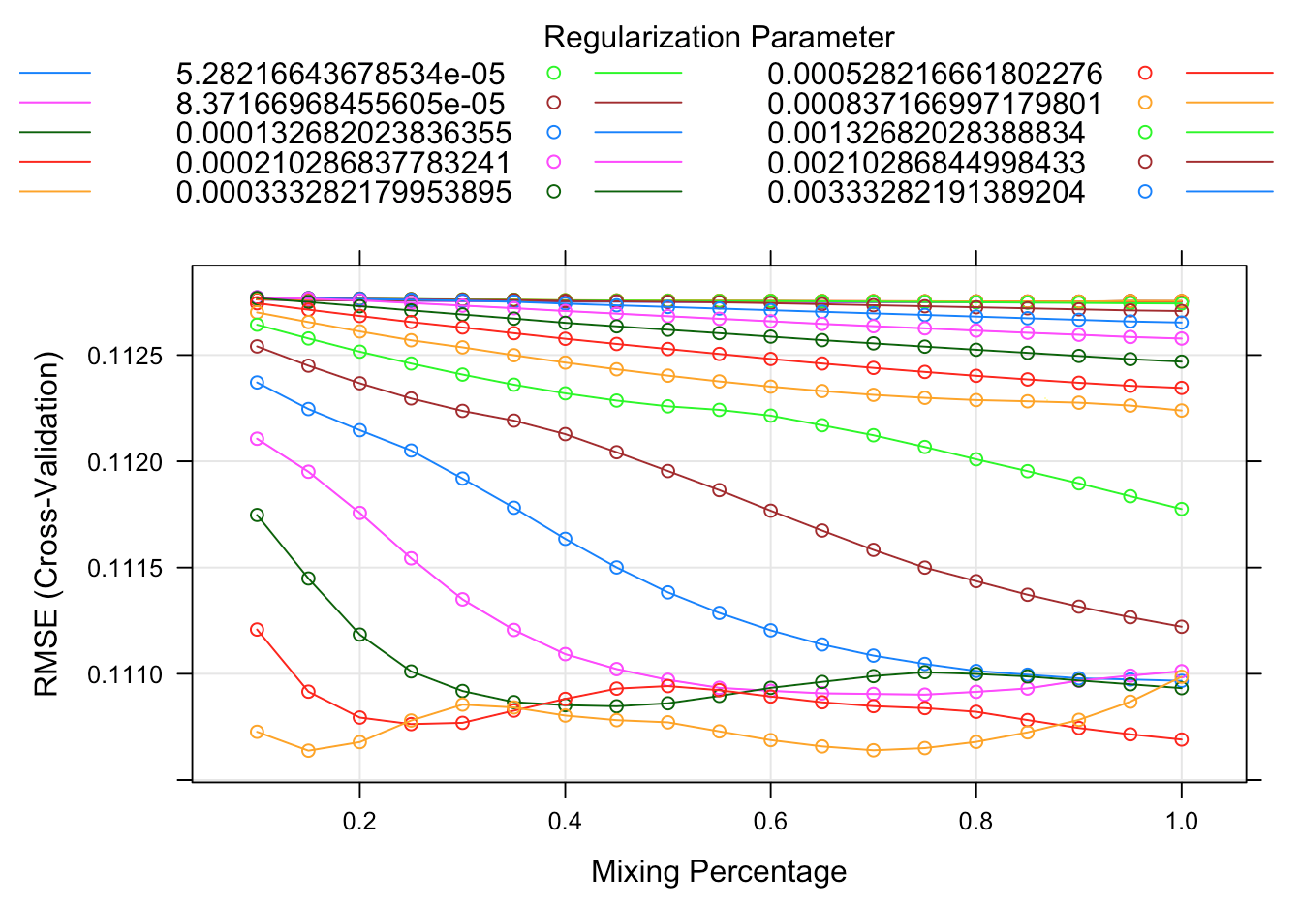
Results - Quarterly Return - Elastic Net
Notes:
And we will further investigate the elastic net model. Here’s the tuning result for elastic net. The horizontal axis represents the mixing percentage, or alpha. The vertical axis represents cross-validated RMSE, and each line represents a different lambda. Here the orange line at the bottom with a mixing percentage of 0.15 has the smallest RMSE, so this should be our best model.

Slide 27
The Best Model - Quarterly Return
Type | 𝛼 | λ
Elastic net | 0.15 | 0.021
Cross-validated RMSE | Test RMSE
0.1106 | 0.0993
Notes:
So our best model is an elastic net regularization with alpha 0.15 and lambda 0.021. The cross-validated RMSE is about 11%, and the test RMSE is 9.93%. I can interpret this as our prediction of quarterly return will be off by 9.93% on average. So imagine that we give you a prediction of a stock’s return in three months, and it will be off by about 10% on average, I don’t think you will be really confident to invest on this, because 10% error is too much. So we think this is probably not a good model. And in fact, stock price and stock return are indeed very hard to predict. Next, Cang will talk more about the prediction of quarterly standard deviation.

Slide 28
Results - Quarterly SD
Model | Cross-validated RMSE | Test RMSE
Linear regression | 0.0041 | 0.0042
K-nearest neighbors | 0.0045 | 0.0042
Ridge | 0.0041 | 0.0040
Elastic net | 0.0041 | 0.0040
Notes:
We tried the same sets of models as before, linear regression, K-nearest neighbors, ridge, and elastic net. As mentioned before, since the algorithm of elastic net has already included lasso, we didn’t set up a pipeline for it.
We can see that KNN performed the worst among all the models. Linear regression got the same result as ridge and lasso in cross-validation, but a bit worse in the test set. Which shows that there is some overfitting problem in this dataset, and we need regularization.
And as ridge and elastic net gave the same result, we chose the simpler model, ridge regression.

Slide 29
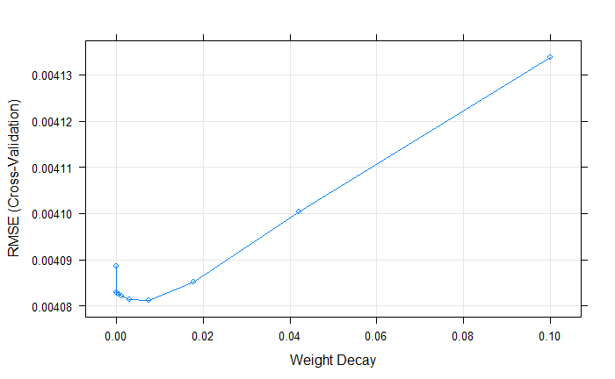
Results - Quarterly SD - Ridge
Notes:
Now let’s see the hyperparameters. Weight decay is lambda of the ridge penalty. When lambda is zero, it is the same as linear regression. If lambda is too big, too much bias would be introduced to the model, and accuracies goes down. As shown in the graph, the minimum RMSE point is at 0.0075.

Slide 30
The Best Model - Quarterly SD
Type | λ | Cross-validated RMSE | Test RMSE
Ridge | 0.0075 | 0.0041 | 0.0040
Notes:
We can see the final result here, with the best lambda, cross-validation rmse is 0.0041, test rmse is 0.004.

Slide 31
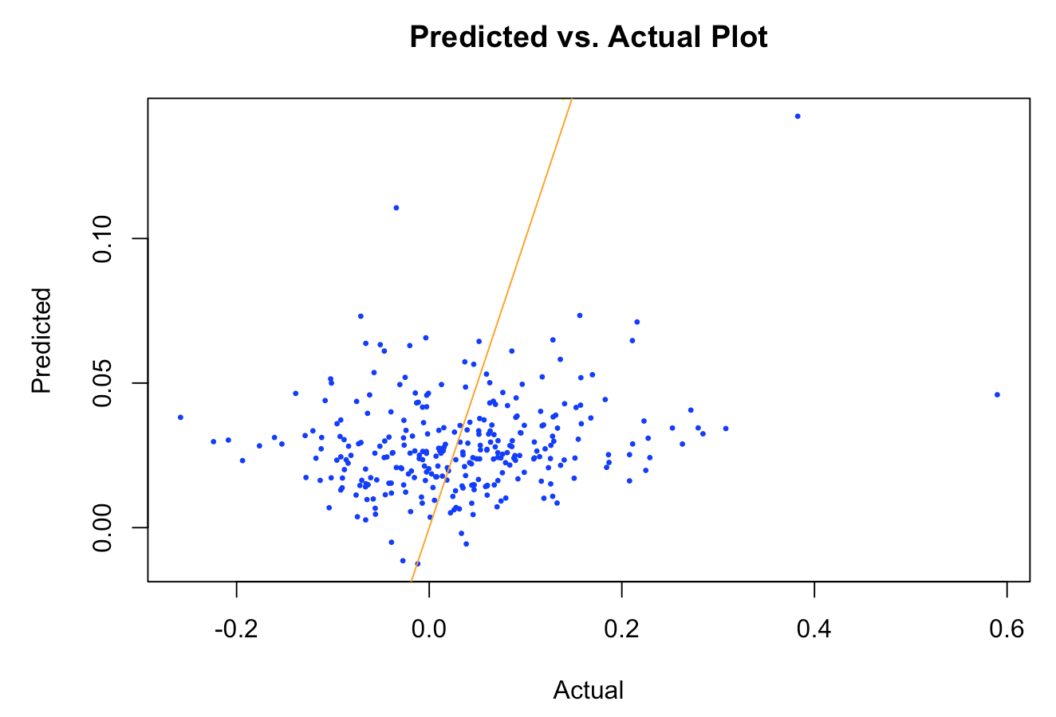
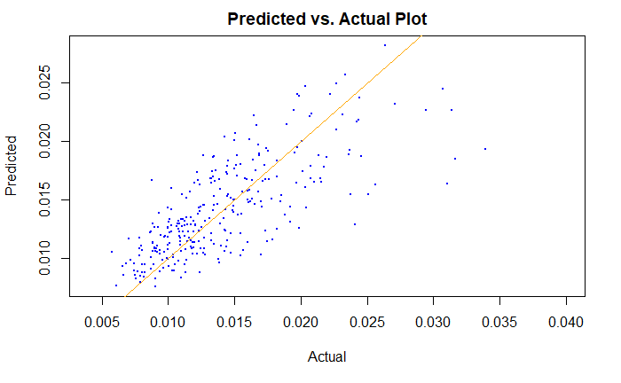
Best Model Comparison - Quarterly SD
 | Quarterly Return | Quarterly SD
Test R-square | 0.0408 | 0.4941
Notes:
Finally, let’s compare the results for the two targets. From our experience in this project, we found that predicting risk is a lot easier than predicting return.
On the left side we have quarterly return, and on the right side we have standard deviation. We can see that the standard deviation‘s r-square is a lot higher than the return’s r-square, meaning that variance of the response was better explained in the standard deviation model.
We have also visualized the predicted values and the actual values. The orange line here is not the regression line, it shows the scenario when the predicted values are equal to the actual ones.
For predicting quarterly return, the dots are quite dispersed around the orange line. Negative returns were overestimated, positive returns were underestimated. And there are some outliers when return is too high, like above 0.4.
For predicting standard deviation, the dots are distributed a lot closer to the orange line, and our prediction was quite accurate, especially when the actual standard deviation is smaller than 0.022. But when the standard deviation is greater than 0.025, the model does not perform as well, and the residuals become larger.

Slide 32


Thank you!
Q & A
Solutions:

Slide 33
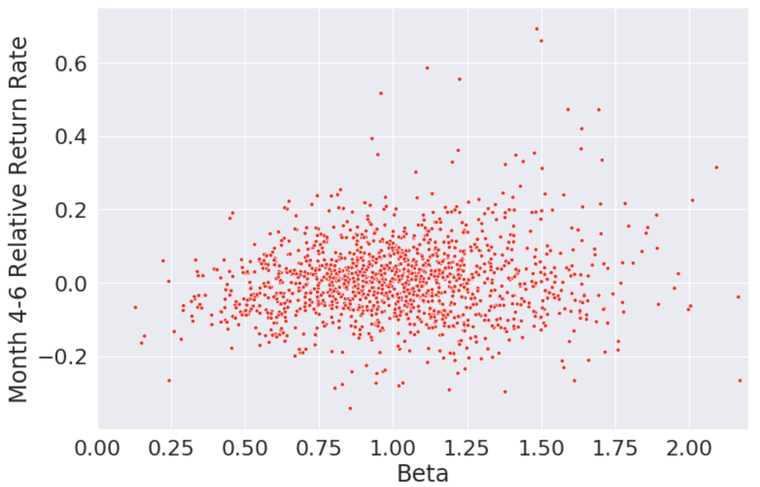
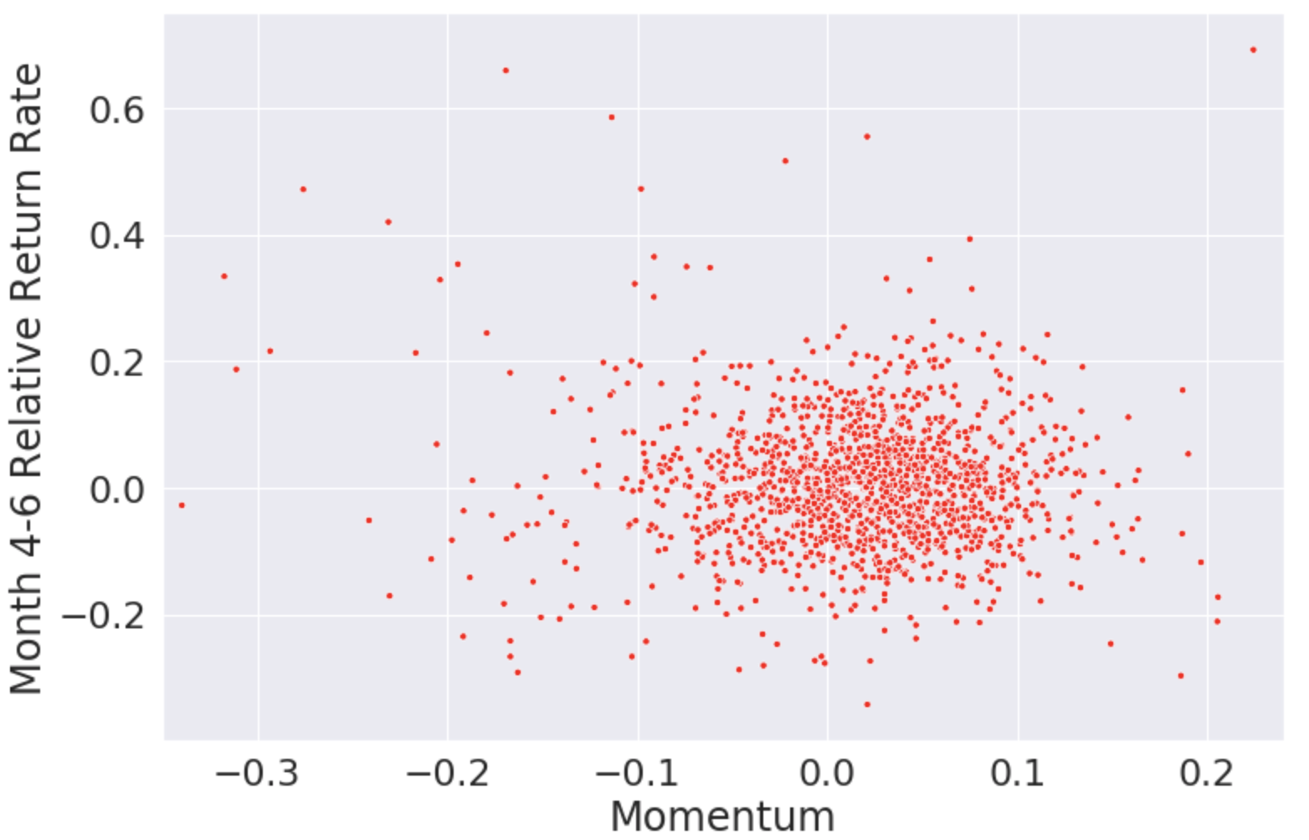
EDA--Advanced, Relative Return Rate

Slide 34
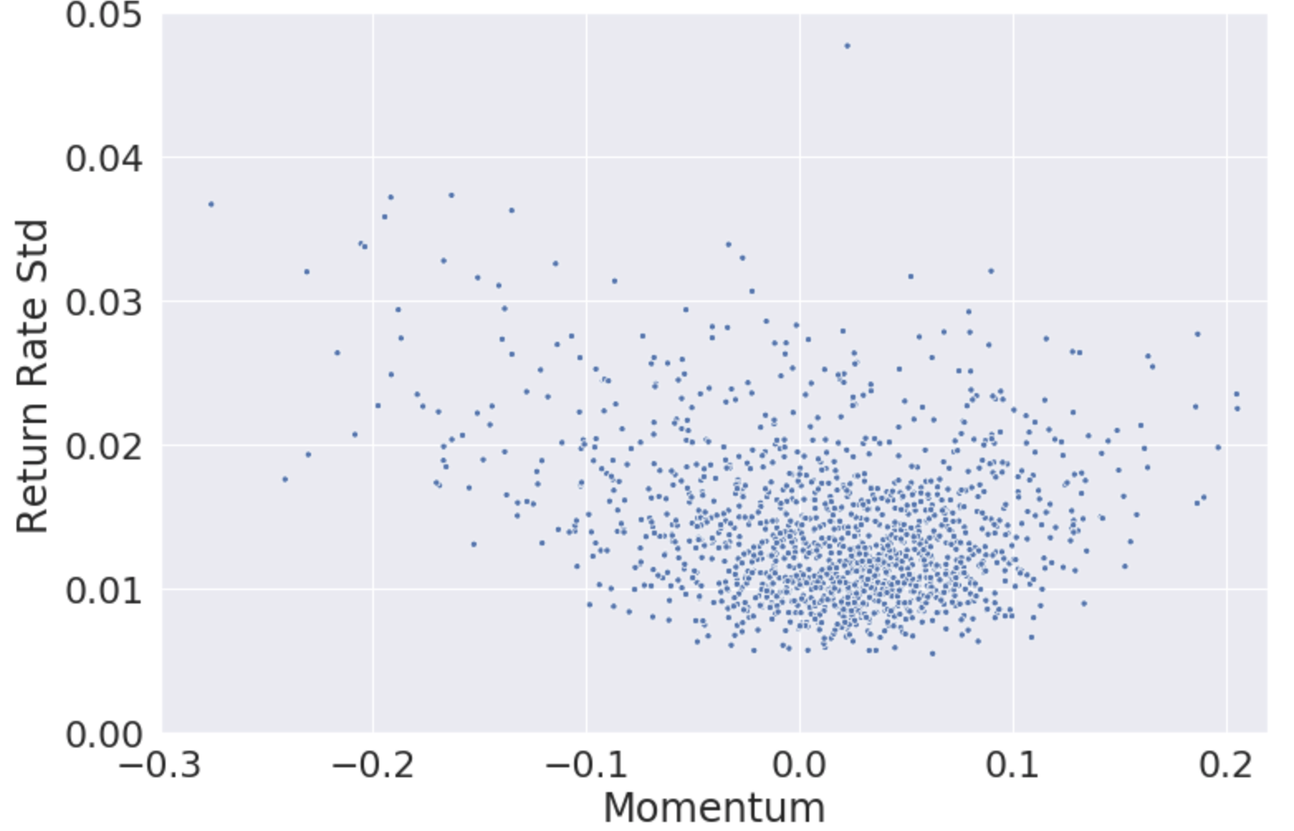
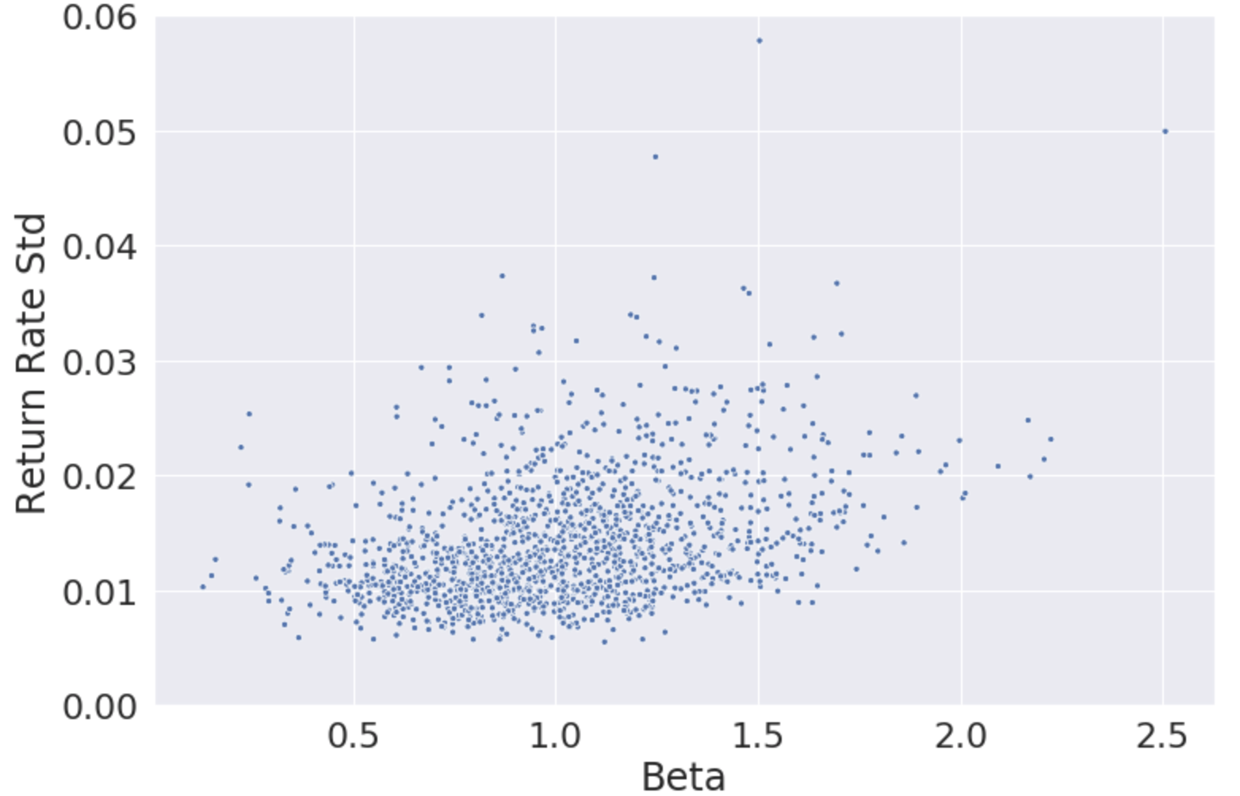
EDA--Advanced, Quarterly Standard Deviation

